Slide 1
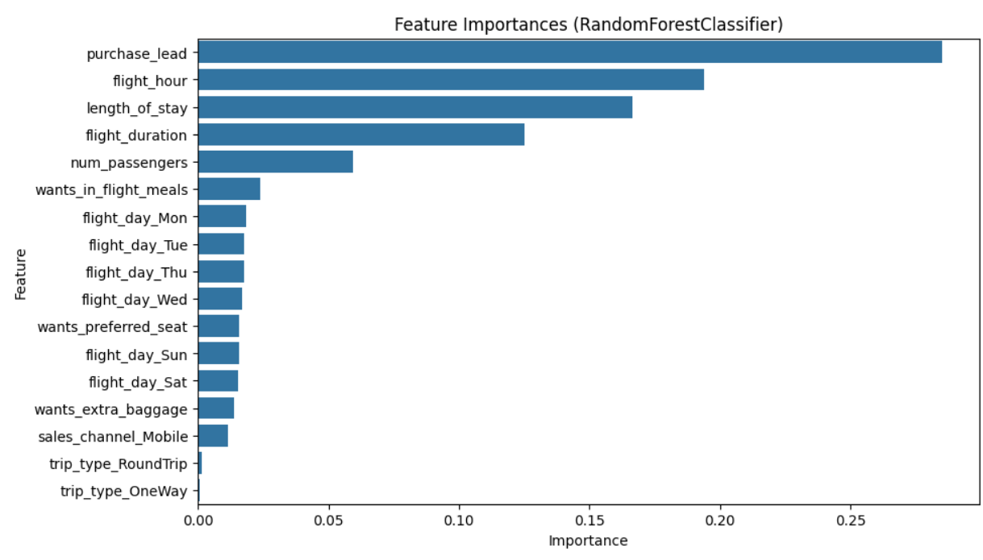
Predicting customer buying behaviour
summary of the key findings from the customer booking analysis:
Feature Importance Visualization:
Data Overview: The dataset was clean with no missing values, but required some preparation due to categorical data.
Predictive Model: We trained a model to predict customer bookings, achieving reasonable overall accuracy (around 85%).
Model Performance: While accurate overall, the model needs improvement in identifying actual bookings due to the low number of bookings in the data.
Key Factors: The most important factors influencing bookings are how far in advance a customer books, the time of day of the flight, the length of the stay, and the flight duration.
As shown in the chart, 'purchase_lead', 'flight_hour', 'length_of_stay', and 'flight_duration' are the most influential features in predicting customer bookings

